Slide 1
Creating R programs using Jupyter notebook
Megha Patel
Economist
Office of Price and Living Conditions
Acceptance Testing Team

Slide 2
Background
Master’s Graduate in Economic Development - Vanderbilt University
  Specialization: Economics of Poverty in Developed and Developing Countries, Microeconomics
Undergraduate Degree: Economics – Rutgers University
Skillset: R/RStudio, Python, STATA
  Mapping, Data Visualizations, and Statistics

Slide 3
Presentation Flow
What is Jupyter Notebook?
Advantages for R Users
Building A Data Science Project

Slide 4
Jupyter Notebook
“The Jupyter Notebook is an open-source web application that allows you to create and share documents that contain live code, equations, visualizations and narrative text. Uses include: data cleaning and transformation, numerical simulation, statistical modeling, data visualization, machine learning, and much more.”
  https://jupyter.org/
  Supports over 40 Languages
Notes:
“Notebooks can be shared with others using email, Dropbox, GitHub and the Jupyter Notebook Viewer.
Your code can produce rich, interactive output: HTML, images, videos, LaTeX, and custom MIME types.
Leverage big data tools, such as Apache Spark, from Python, R and Scala. Explore that same data with pandas, scikit-learn, ggplot2, TensorFlow.”
Documentation: https://jupyter-notebook.readthedocs.io/en/stable/

Slide 5
What’s the Advantage for R Users?
Easy to Build Projects for Users
  Interface makes it easier to connect different outputs with coding lines
Organizing Complex Data Science Projects
  R/SAS, R/SQL, R/Python, etc.
Readability and Accessibility
  File outputs are readable and interactive for audiences

Slide 6
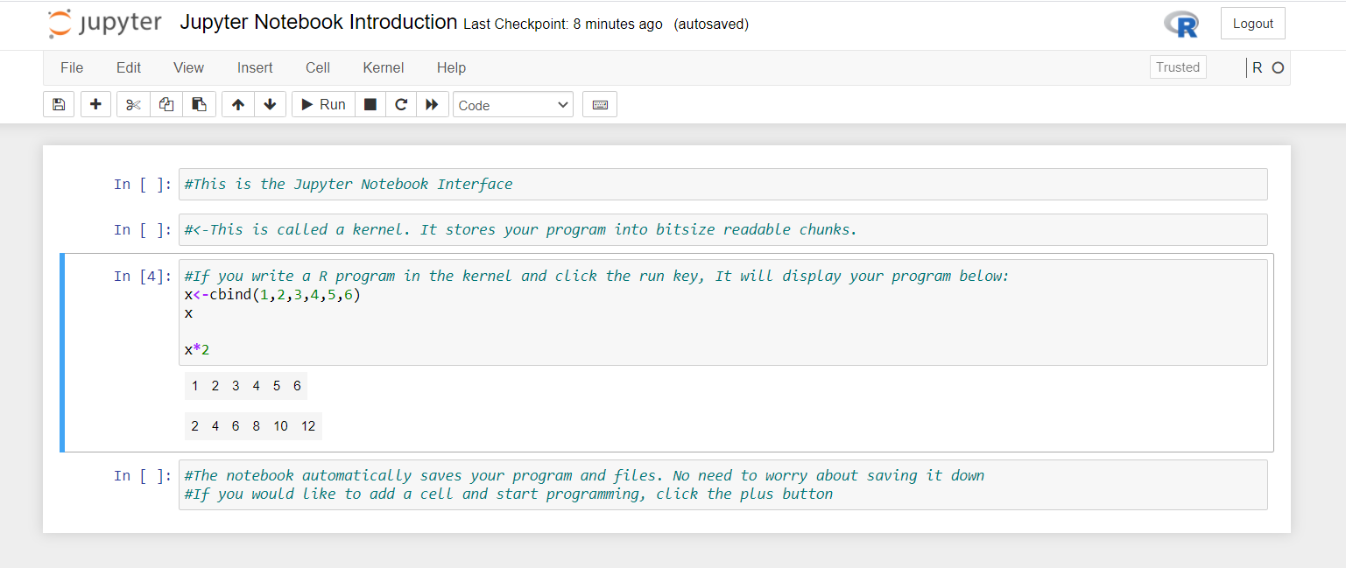
Jupyter Notebook Interface
Notes:
Output and code are together. You can directly see the output below the code that was written. If you are compiling large chunks of code across different data sets and need to organize files, output, and share with others, the Jupyter Notebook interface creates files that visualizes your process. You can then save it as an HTML File or R Markdown File for different users to view your program.

Slide 7
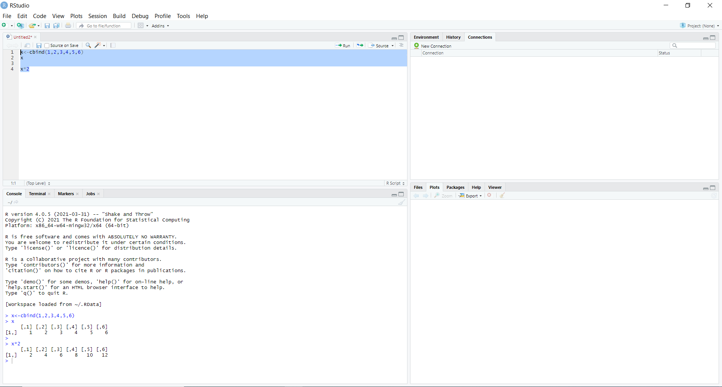
RStudio Interface
Notes:
Output and code are separated – You have to look at a few different places on your screen to see the program and output for larger codes. You can create HTML or Markdown Files in RStudio.

Slide 8
Building A Data Science Project
Social Origins of Inventors
  Aim: Find birthplaces of engineers in the United States
  Results: Low Fit of model suggests that neighborhood level characteristics are not as predictive for female engineers as they are for male engineers
  Tools: R/RStudio and Jupyter Notebook
  Data Source: Opportunity Insights
    Raj Chetty, Harvard University
Notes:
Data Source: https://opportunityinsights.org/data/
Paper Replication: Where is the Land of Opportunity? The Geography of Intergenerational Mobility in the United States

Slide 9
Demo

Slide 10
Results Using Jupyter Notebook

Slide 11
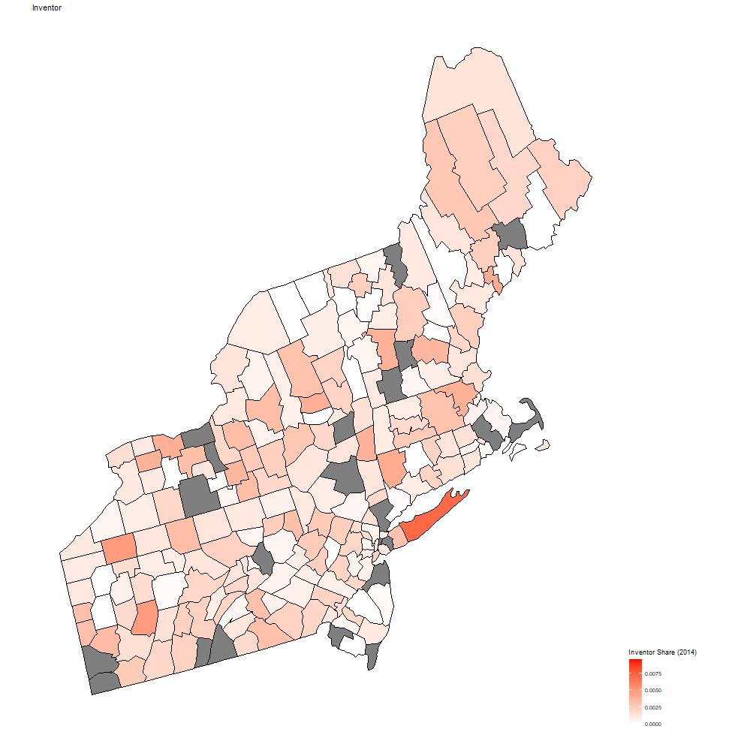
Plotting ggplot2 objects on the Jupyter Notebook Interface
Notes:
Graphs the share of inventors in the Northeast Region
Jupyter Notebooks produces ggplot2 images.
jpeg(file = “INSERT FILE PATH HERE", width = 975, height = 975)
map1<-plot_usmap(data=us_map_data, values="num.inventor", color="black" , include=.northeast_region)+labs(color="num.inventor")+ scale_fill_continuous( low = "white", high = "red", name = "Inventor Share (2014)")+ theme(legend.position = "right")+ggtitle("Inventor")
map1
dev.off()
map1

Slide 12
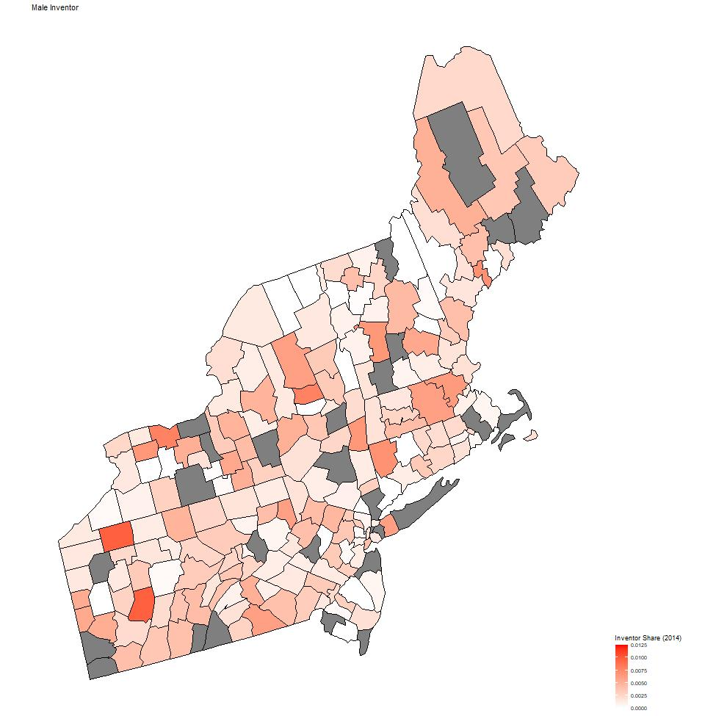
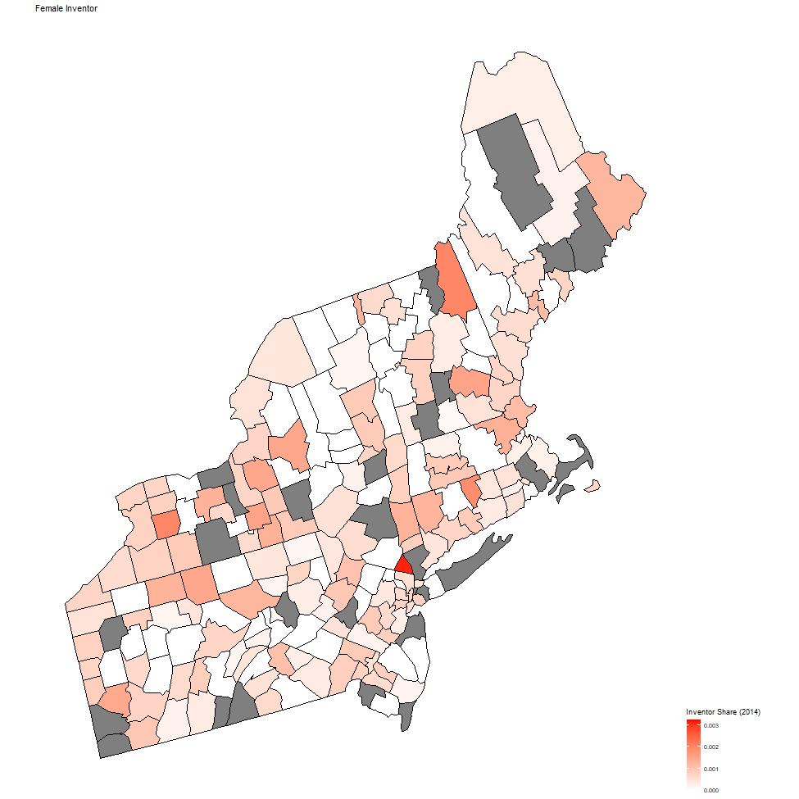
Notes:
Side by side Comparison of Male Inventors and Female Inventors for the Northeast Region

Slide 13
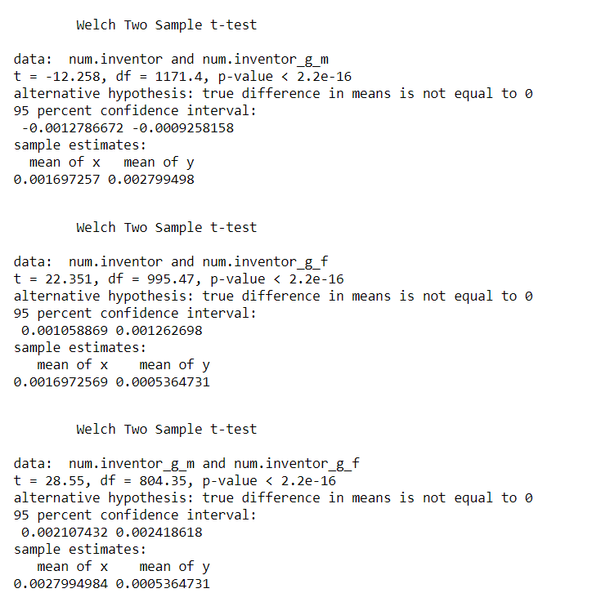
Outputs for Building T-Tests
Notes:
https://statistics.berkeley.edu/computing/r-t-tests
Programming lines for building a two sample t-test
t.test.1<-t.test(num.inventor, num.inventor_g_m)
t.test.2<-t.test(num.inventor,num.inventor_g_f)
t.test.3<-t.test(num.inventor_g_m,num.inventor_g_f)
t.test.1
t.test.2
t.test.3

Slide 14
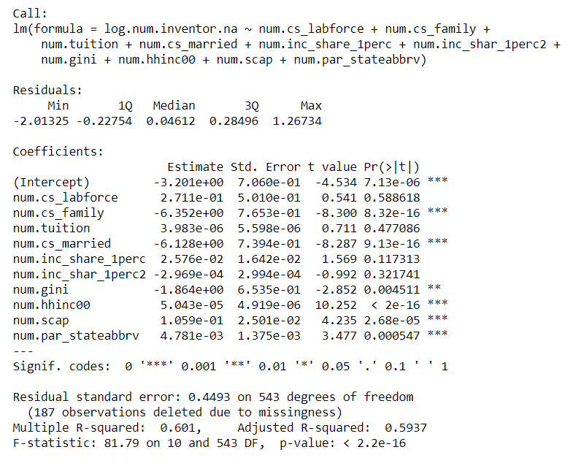
lm(): Multiple Regression
Notes:
https://www.statmethods.net/stats/regression.html
Coding Lines:
You are storing the regression model into a vector and printing a summary of the vector to call the output
inventor_model<-lm(log.num.inventor.na ~ num.cs_labforce+num.cs_family+num.tuition+num.cs_married+num.inc_share_1perc+ num.inc_shar_1perc2+num.gini+num.hhinc00+num.scap +num.par_stateabbrv)
print(summary(inventor_model))

Slide 15
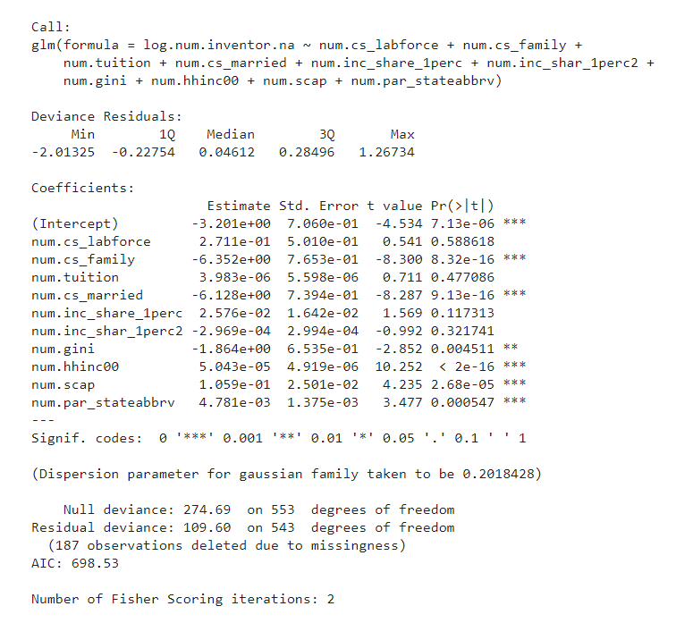
glm(): Gaussian Family Regression Models
Notes:
glm is used to fit generalized linear models, specified by giving a symbolic description of the linear predictor and a description of the error distribution.
https://www.rdocumentation.org/packages/stats/versions/3.6.2/topics/glm
http://www.gaussianprocess.org/gpml/chapters/RW2.pdf
Programming Lines
inventor_model_glm<-glm(log.num.inventor.na ~ num.cs_labforce+num.cs_family+num.tuition+num.cs_married+num.inc_share_1perc +num.inc_shar_1perc2+num.gini+num.hhinc00+num.scap+num.par_stateabbrv)
print(summary(inventor_model_glm))
NOTE: This model was created for demonstration purposes. The LM model was determined as best fit at the time.

Slide 16
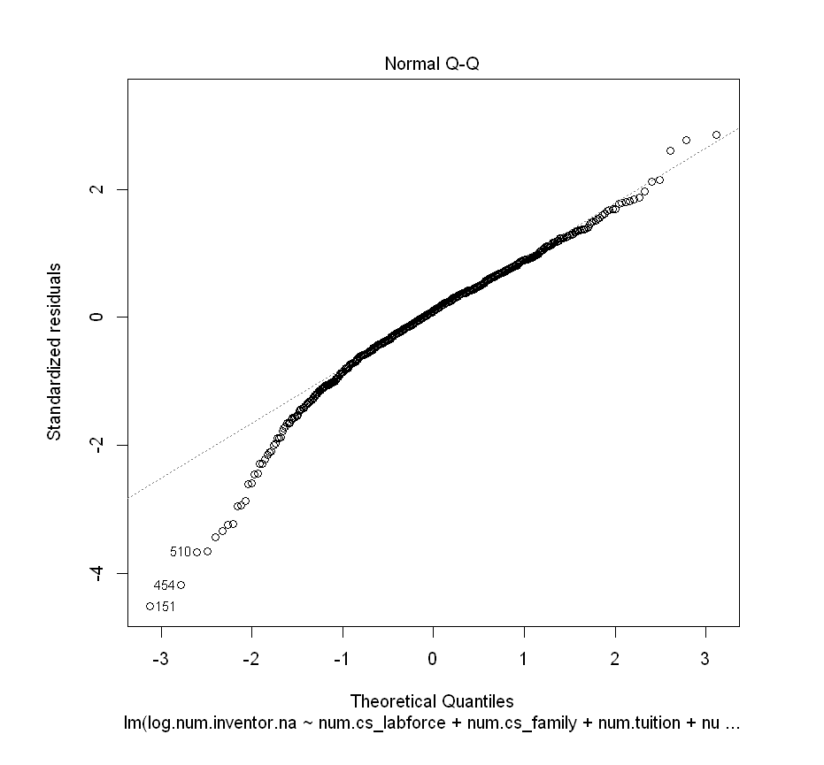
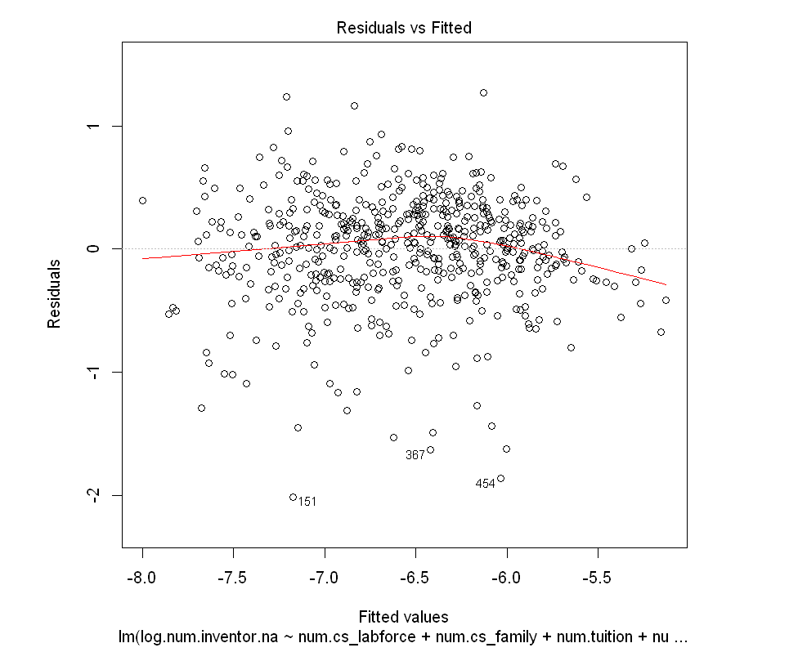
Regression Diagnostics
Notes:
Basic plots for regression analysis. Interpretation of the plots can be found here: https://data.library.virginia.edu/diagnostic-plots/
Programming Lines:
inventor_reg_diagnostics<-plot(inventor_model)
inventor_reg_diagnostics

Slide 17
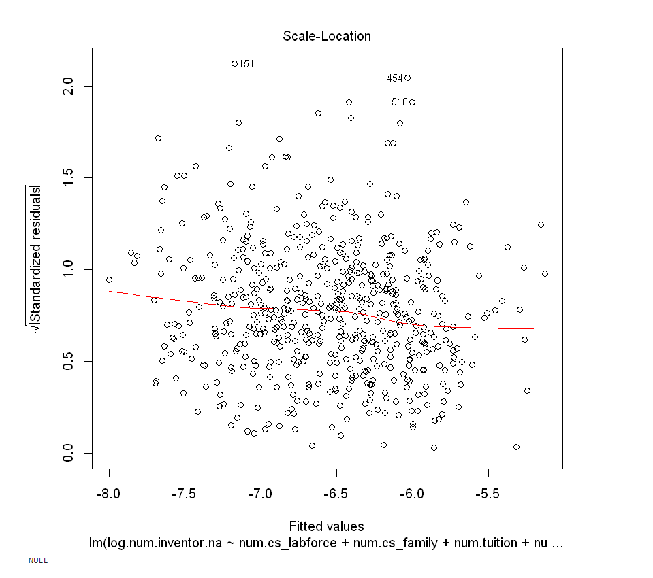
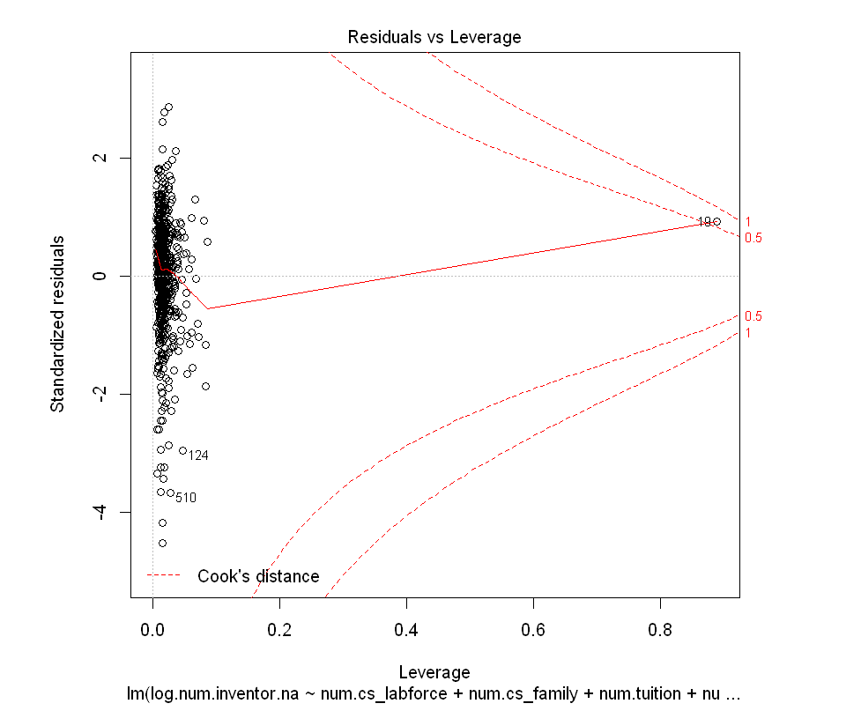
Notes:
Note: There were outliers in the data set

Slide 18
Packages
dplyr
readstata13
usmap
ggplot2
regtools
tidyverse
Notes:
For SAS Files: https://www.rdocumentation.org/packages/haven/versions/2.4.3/topics/read_sas

Slide 19
Attachment Folder Contents
Working Files
Original Data Sets
Text File for R Codes
HTML Files
Results Folder

Slide 20
Megha S Patel
732-762-8181
patel.megha@bls.gov
https://github.com/msp156
https://www.linkedin.com/in/megha-patel-01a376a8

